Slide 1
Custom K8S/OCP automation with Operator Framework
For The PaaS Admins
By : Oren Oichman
Title: Senior Consultant - Red Hat
ooichman@redhat.com
IRC: two_oes/ooichman

Slide 2



Slide 3
What is an Operator ?
An Operator is a method of packaging, deploying and managing a Kubernetes application
An Operator is an application that is both deployed on Kubernetes and managed using the Kubernetes APIs and kubectl tooling.
Runtime that manages this type of application on Kubernetes.

Slide 5

Operators simplify management of complex applications
on Kubernetes
●
Encode human operational knowledge
●
Automatically patch, upgrade, recover, and tune
container-based apps and services
●
Kubernetes-native
●
Purpose-built for a speciﬁc application or service
●
Enable “day 2” management

Slide 6
Basic Architecture of an Operator
k8s API
Controller
My Application
Custom Resource
Watch Events
Reconciliation
MyApplication
State

Slide 7
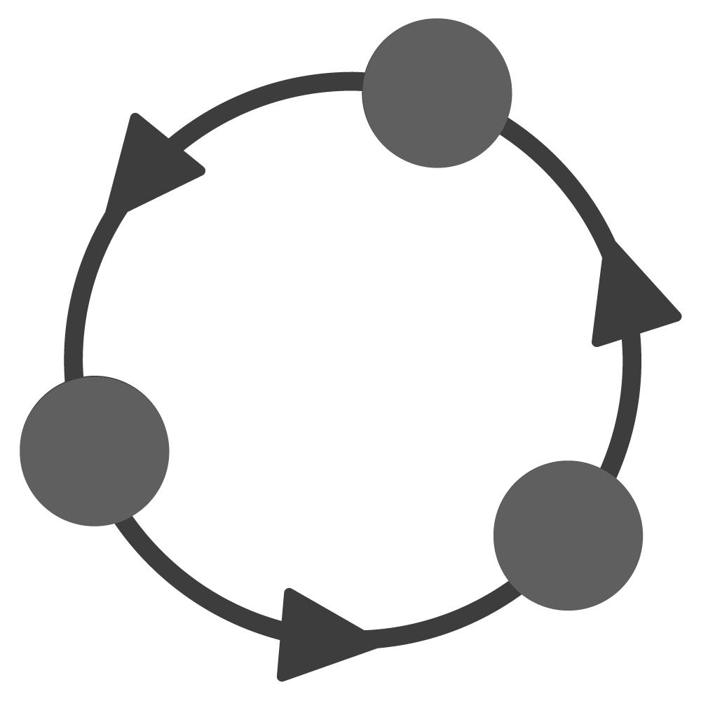
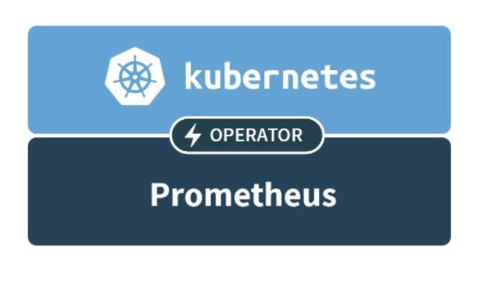

WITHOUT OPERATORS: REACTIVE
WITH OPERATORS: PROACTIVE

Slide 8



github.com/operator-framework

Slide 9





Slide 11



Phase I
Phase II
Phase III
Phase IV
Phase V
Basic Install
Seamless Upgrades
Full Lifecycle
Deep Insights
Auto Pilot
Automated application
Patch and minor version
App lifecycle, storage
Metrics, alerts, log
Horizontal/vertical scaling,
provisioning and
upgrades supported
lifecycle (backup, failure
processing and workload
auto conﬁg tuning, abnormal
conﬁguration management
recovery)
analysis
detection, scheduling tuning

Slide 12
Basic Architecture of an Ansible Operator
My Application
k8s API
Custom Resource
MyApplication
State
Watches
File
reads
Ansible k8s modules will be used to create resources in kubernetes
Operator SDK
binary
executes
Ansible Content

Slide 13
Inside the Ansible Operator
Custom kubeconfig
Operator SDK binary
creates
Watches
File
reads
ansible-runner
reads
metrics
executes
proxy
k8s API
executes
Ansible Content

Slide 14
your Operator image
Ansible Role
watches.yaml
Ansible Role
base Ansible Operator SDK image
Operator SDK Binary
Ansible
ansible-runner
Python + Libraries

Slide 15

Exercise 3
Oren Oichman - custom K8S automations with Operators

Slide 16

Thank you
Red Hat is the world’s leading provider of enterprise open source software solutions. Award-winning support, training, and consulting services make
Red Hat a trusted adviser to the Fortune 500.

